Slide 1
.Net
WEB ENGINEERING

Slide 2
Week 2 - Day 6

Slide 3

Learning Objectives
By the end of this session, the students will have developed an understanding of:
What is jQuery
jQuery Syntax
jQuery Selectors
Manipulating HTML DOM with jQuery

Slide 4
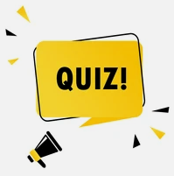
JavaScript Quiz
Total Marks: 20
Time Allocated: 1 hr

Slide 5

: Basics

Slide 6

Install JQuery
JQuery will be installed in all the computers before starting its introduction.

Slide 7
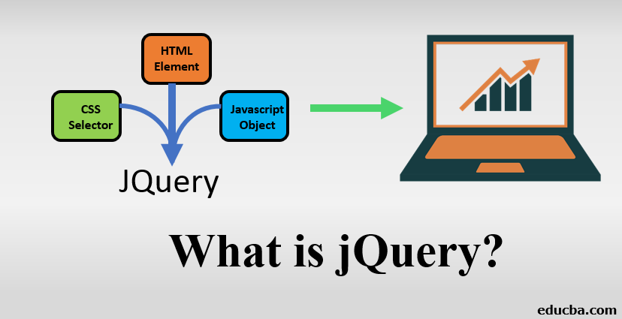

Slide 8
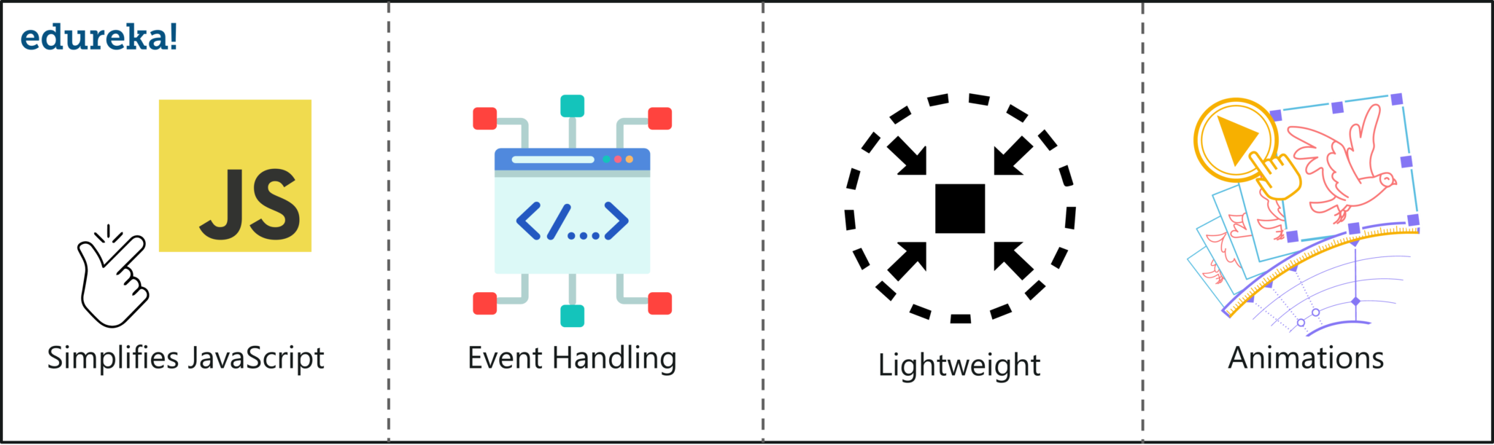
What is jQuery?
Notes:
jQuery is an efficient & fast JavaScript Library created by John Resig in 2006. The motto of jQuery is write less, do more, which is very apt because it’s functionality revolves around simplifying each and every line of code. Here is a list of jQuery key features:

Slide 9
What is JQuery
Simplifies JavaScript:
It simplifies DOM manipulation and event handling for rapid web development
Event handling:
jQuery offers an effective manner to capture a wide variety of events, such as a user clicking on a link, without the need to clutter the HTML code
Lightweight:
jQuery is a compact, lightweight library of about 19KB in size
Animations:
It comes with plenty of built-in animation effects which you can use in your web app to make it more interactive

Slide 10
What is it?
A library of JavaScript functions, just like...
Prototype
YUI
Dojo
mooTools
Notes:
https://www.slideshare.net/abc2303/jquery-11169208?qid=5432412a-8b60-418f-a45e-2963d038e2e8&v=&b=&from_search=5
https://www.slideshare.net/simon/learning-jquery-in-30-minutes

Slide 11
What is it?
The jQuery library contains the following features:
HTML element selections
HTML element manipulation
CSS manipulation
HTML event functions
JavaScript effects and animations
HTML DOM traversal and modification
AJAX
Utilities
An open source project, maintained by a group of developers with active support base and well written documentation.

Slide 12
jQuery philosophy
Focus on the interaction between JavaScript
and HTML
(Almost) every operation boils down to:
Find some stuff
Do something to it
Notes:
https://www.slideshare.net/simon/learning-jquery-in-30-minutes

Slide 13

Notes:
https://www.educba.com/uses-of-jquery/?source=leftnav

Slide 14
jQuery
a fast, small JavaScript library included in a single .js file
built-in functions
a framework built using JavaScript capabilities.
all the functions and other capabilities available in JavaScript can be used
Any JavaScript editor can be used to write jQuery such as
Notepad
Visual Studio
Eclipse
Ultra edit
Notes:
https://www.educba.com/uses-of-jquery/?source=leftnav
JQuery is a fast, small JavaScript library included in a single .js file.
It provides many built-in functions using which you can accomplish various tasks easily and quickly.
JQuery is a framework built using JavaScript capabilities. Hence, you can use all the functions and other capabilities available in JavaScript.
You can use any JavaScript editor to write jQuery such as
Notepad
Visual Studio
Eclipse
Ultra edit

Slide 15
Advantages of jQuery
Easy to learn: jQuery is easy to learn because it supports same JavaScript style coding.
Write less do more: jQuery provides a rich set of features that increase developers' productivity by writing less and readable code.
Excellent API Documentation: jQuery provides excellent online API documentation.
Cross-browser support: jQuery provides excellent cross-browser support without writing extra code.
Unobtrusive: jQuery is unobtrusive which allows separation of concerns by separating html and jQuery code.

Slide 16
Features of jQuery
jQuery includes the following features:
DOM element selections using the cross-browser open source selector engine Sizzle, a spinoff out of the jQuery project
DOM traversal and modification (including support for CSS 1-3)
DOM manipulation based on CSS selectors that uses node elements name and node elements
attributes (id and class) as criteria to build selectors
Events
Effects and animations
Ajax
Extensibility through plug-ins
Cross-browser support

Slide 17
Features of jQuery
jQuery simplifies various tasks of a progammer by writing less code. Here is the list of important core features supported by jQuery −
DOM manipulation − The jQuery made it easy to select DOM elements, negotiate them and modifying their content by using cross-browser open source selector engine called Sizzle.
Event handling − The jQuery offers an elegant way to capture a wide variety of events, such as a user clicking on a link, without the need to clutter the HTML code itself with event handlers.
AJAX Support − The jQuery helps you a lot to develop a responsive and feature rich site using AJAX technology.

Slide 18
Features of jQuery
Animations − The jQuery comes with plenty of built-in animation effects which you can use in your websites.
Lightweight − The jQuery is very lightweight library - about 19KB in size (Minified and gzipped).
Cross Browser Support − The jQuery has cross-browser support, and works well in IE 6.0+, FF 2.0+, Safari 3.0+, Chrome and Opera 9.0+
Latest Technology − The jQuery supports CSS3 selectors and basic XPath syntax.

Slide 19
Setting up jQuery
There are two ways to use jQuery.
Local Installation − You can download jQuery library on your local machine and include it in your HTML code.
CDN Based Installation − You can include jQuery library into your HTML code directly from Content Delivery Network (CDN).
Notes:
for further information: https://www.tutorialspoint.com/jquery/jquery-overview.htm

Slide 20
JQuery Syntax

Slide 21
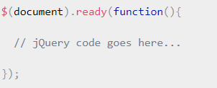
Document Ready Event
Before we look into jQuery Syntax, let's try to understand what is Document Ready Event. Actually, before we execute any jQuery statement, we would like to wait for the document to be fully loaded.
This is because jQuery works on DOM and if complete DOM is not available before executing jQuery statements, then we will not get desired result.
Notes:
https://www.tutorialspoint.com/jquery/jquery-syntax.htm#

Slide 22
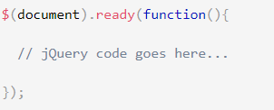
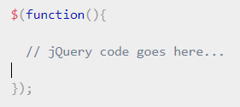
Document Ready Event
Following is basic syntax of a Document Ready Event:
Alternatively you can also use the following syntax for document ready event:
Notes:
https://www.tutorialspoint.com/jquery/jquery-syntax.htm#

Slide 23
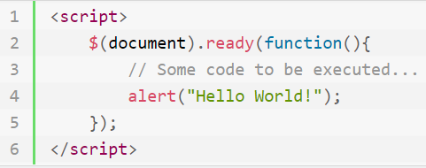
Standard jQuery Syntax
A jQuery statement typically starts with the dollar sign ($) and ends with a semicolon (;).
In jQuery, the dollar sign ($) is just an alias for jQuery. Let's consider the following example code which demonstrates the most basic statement of the jQuery.
Try this code on your computers and then check its output here.

Slide 24
JQuery Syntax
With jQuery you select (query) HTML elements and perform "actions" on them.
The jQuery syntax is tailor made for selecting HTML elements and perform some action on the element(s).
Basic syntax is: $(selector).action()
A dollar sign to define jQuery
A (selector) to "query (or find)" HTML elements
A jQuery action() to be performed on the element(s)
Notes:
https://www.geeksforgeeks.org/javascript-basic-syntax/?ref=lbp

Slide 25
Examples:
$(this).hide() - hides current element
$("p").hide() - hides all paragraphs
$("p.test").hide() - hides all paragraphs with class="test"
$("#test").hide() - hides the element with id="test"

Slide 26
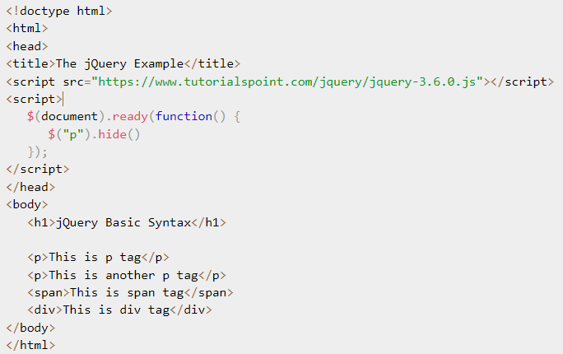
Example
Here are few examples to illustrate the basic jQuery Syntax. This example will select all the <p> elements from an HTML document and will hide those elements.
Write this code on your computer and tally your output from the one given on the next slide.
Notes:
https://www.tutorialspoint.com/jquery/jquery-syntax.htm#

Slide 27
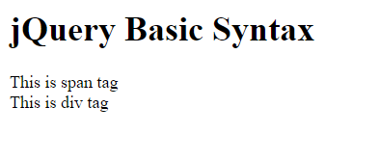
Output

Slide 28
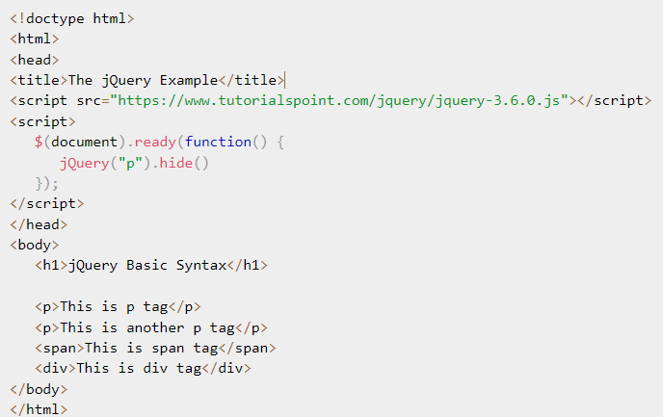
Example
Let's re-write the above example using jQuery() method instead of $():
Write this code on your computer and tally your output from the one given on the next slide.
Notes:
https://www.tutorialspoint.com/jquery/jquery-syntax.htm#

Slide 29
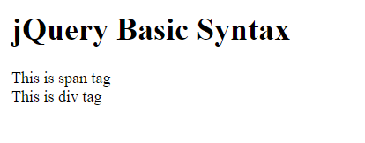
Output
Notes:
For more examples of Jquery syntax: https://www.tutorialspoint.com/jquery/jquery-syntax.htm#

Slide 30
jQuery - Selectors
jQuery Selectors are used to select HTML element(s) from an HTML document. Consider an HTML document is given and you need to select all the <div> from this document. This is where jQuery Selectors will help.
jQuery Selectors can find HTML elements (ie. Select HTML elements) based on the following:
HTML element Name
Element ID
Element Class
Element attribute name
Element attribute value
Many more criteria

Slide 31
jQuery - Selectors
The jQuery library harnesses the power of Cascading Style Sheets (CSS) selectors to let us quickly and easily access elements or groups of elements in the Document Object Model (DOM).
jQuery Selectors works in very similar way on an HTML document like an SQL Select Statement works on a Database to select the records.

Slide 32
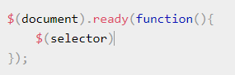
jQuery Selector Syntax
Following is the jQuery Selector Syntax for selecting HTML elements:

Slide 33
jQuery Selector Syntax
Following is the jQuery Selector Syntax for selecting HTML elements:
A jQuery selector starts with a dollar sign $ and then we put a selector inside the braces (). Here $() is called factory function, which makes use of following three building blocks while selecting elements in a given document:

Slide 34
jQuery Selector Syntax
A jQuery selector starts with a dollar sign $ and then we put a selector inside the braces (). Here $() is called factory function, which makes use of following three building blocks while selecting elements in a given document:
Selector Name | Description
The element Selector | Represents an HTML element name available in the DOM. For example $('p') selects all paragraphs <p> in the document.
The #id Selector | Represents a HTML element available with the given ID in the DOM. For example $('#some-id') selects the single element in the document that has some-id as element Id.
The .class Selector | Represents a HTML elements available with the given class in the DOM. For example $('.some-class') selects all elements in the document that have a class of some-class.

Slide 35
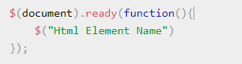
1- The element Selector
The jQuery element selector selects HTML element(s) based on the element name. Following is a simple syntax of an element selector:

Slide 36
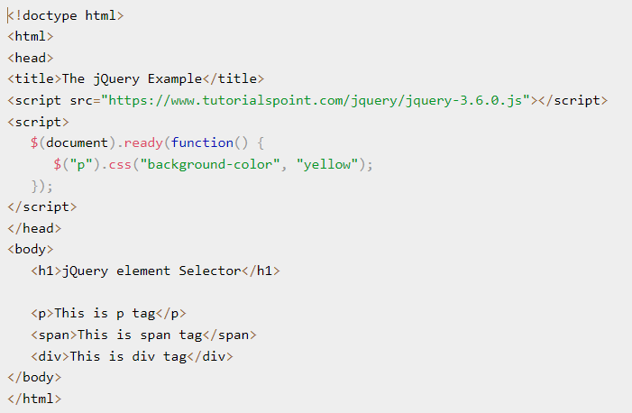
Example
This is an example to select all the <p> elements from an HTML document and then change the background color of those paragraphs. You will not see any <p> element in the output generated by this example.
You can also change the code to use different element names as selector and then move to the next slide to verify the result.

Slide 37
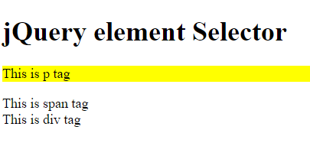
Example Output

Slide 38
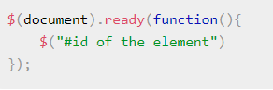
2- The #id Selector
The jQuery #id selector selects an HTML element based on the element id attribute. Following is a simple syntax of a #id selector:

Slide 39
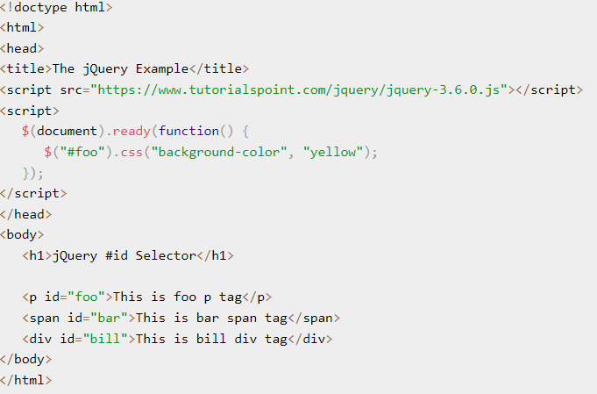
Example
This is an example to select the <p> element whose id is foo and change the background color of those paragraphs..
You can also change the code to use different element names as selector and then move to the next slide to verify the result.

Slide 40
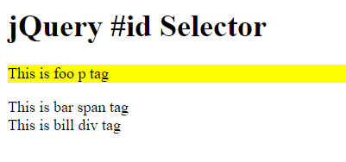
Example Output

Slide 41
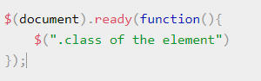
3- The .class Selector
The jQuery .class selector selects HTML element(s) based on the element class attribute. Following is a simple syntax of a .class selector:

Slide 42
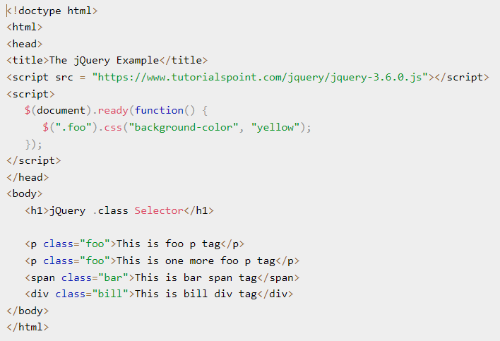
Example
This is an example to select all the elements whose class is foo and change the background color of those elements.
You can also change the code to use different element names as selector and then move to the next slide to verify the result.

Slide 43
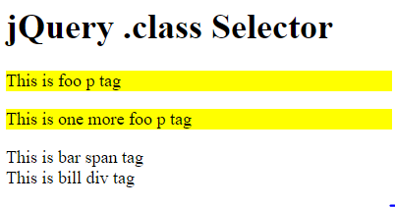
Example Output

Slide 44
jQuery - DOM Manipulation

Slide 45
jQuery - DOM Manipulation
jQuery provides a number of methods to manipulate DOM in efficient way. You do not need to write big and complex code to set or get the content of any HTML element.
jQuery DOM Manipulation
jQuery provides methods such as attr(), html(), text() and val() which act as getters and setters to manipulate the content from HTML documents.
Document Object Model (DOM) - is a W3C (World Wide Web Consortium) standard that allows us to create, change, or remove elements from the HTML or XML documents.

Slide 46
jQuery - DOM Manipulation
Here are some basic operations which you can perform on DOM elements with the help of jQuery standard library methods −
Extract the content of an element
Change the content of an element
Adding a child element under an existing element
Adding a parent element above an existing element
Adding an element before or after an existing element
Replace an existing element with another element
Delete an existing element
Wrapping content with-in an element

Slide 47
jQuery - DOM Manipulation
jQuery provides various methods to add, edit or delete DOM element(s) in the HTML page.
The following table lists some important methods to add/remove new DOM elements.

Slide 48
jQuery - DOM Manipulation
Method | Description
append() | Inserts content to the end of element(s) which is specified by a selector.
before() | Inserts content (new or existing DOM elements) before an element(s) which is specified by a selector.
after() | Inserts content (new or existing DOM elements) after an element(s) which is specified by a selector.
prepend() | Insert content at the beginning of an element(s) specified by a selector.
remove() | Removes element(s) from DOM which is specified by selector.
replaceAll() | Replace target element(s) with specified element.
wrap() | Wrap an HTML structure around each element which is specified by selector.
Notes:
https://www.tutorialsteacher.com/jquery/jquery-dom-manipulation

Slide 49
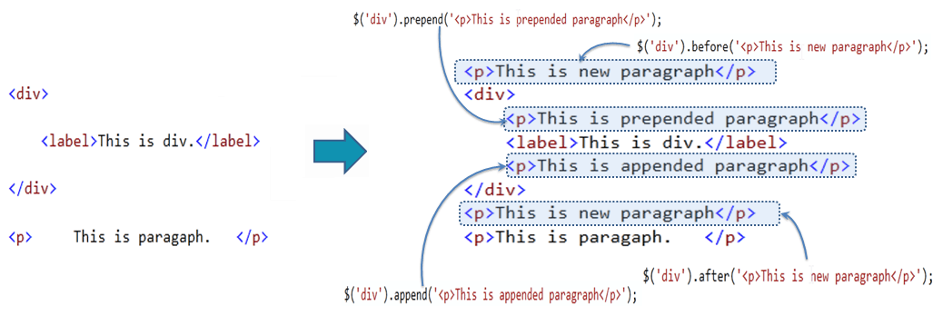
jQuery - DOM Manipulation
The following figure shows how the DOM manipulation methods add new elements.
Notes:
https://www.tutorialsteacher.com/jquery/jquery-dom-manipulation

Slide 50
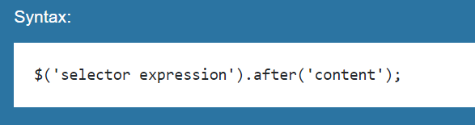
jQuery after() Method
The jQuery after() method inserts content (new or existing DOM elements) after target element(s) which is specified by a selector.

Slide 51
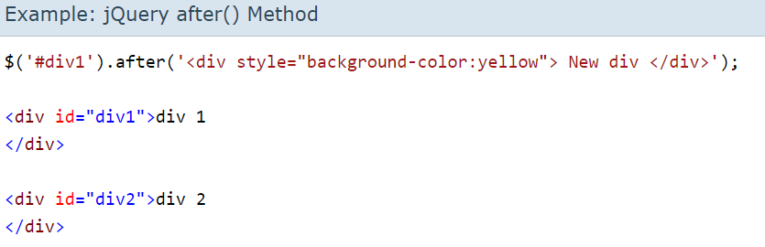
Example: JQuery after() Method
Try the code and check the output here.

Slide 52
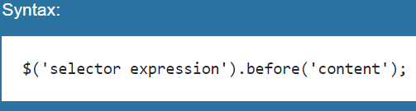
jQuery before() Method
The jQuery before() method inserts content (new or existing DOM elements) before target element(s) which is specified by a selector.
Notes:
https://www.tutorialsteacher.com/jquery/jquery-dom-manipulation

Slide 53
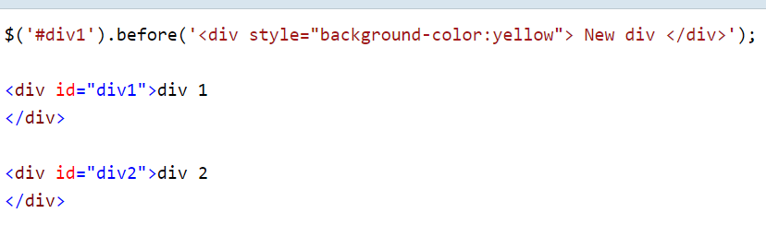
Example: JQuery before() Method
Try the code and check the output here.

Slide 54
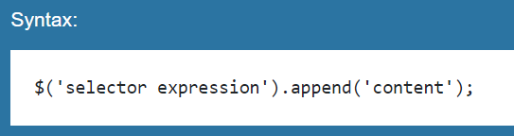
jQuery append() Method
The jQuery append() method inserts content to the end of target element(s) which is specified by a selector.
Notes:
https://www.tutorialsteacher.com/jquery/jquery-dom-manipulation

Slide 55
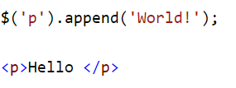
Example: JQuery append() Method
Try the code and check the output here.

Slide 56
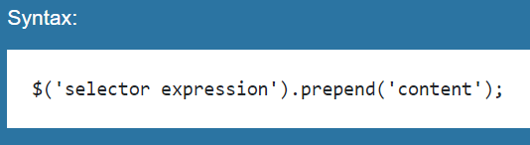
jQuery prepend() Method
The jQuery prepend() method inserts content at the beginning of an element(s) specified by a selector.
Notes:
https://www.tutorialsteacher.com/jquery/jquery-dom-manipulation

Slide 57
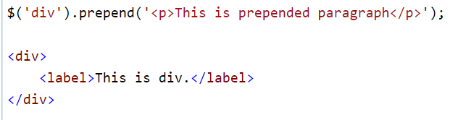
Example: JQuery prepend() Method
Try the code and check the output here.

Slide 58
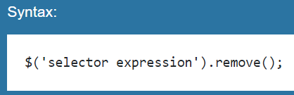
jQuery remove() Method
The jQuery remove() method removes element(s) as specified by a selector.
Notes:
https://www.tutorialsteacher.com/jquery/jquery-dom-manipulation

Slide 59
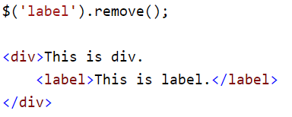
Example: JQuery remove() Method
Try the code and check the output here.

Slide 60
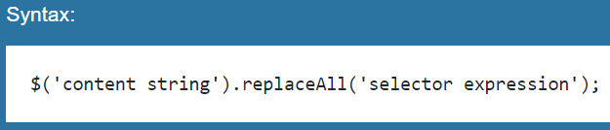
jQuery replaceAll() Method
The jQuery replaceAll() method replaces all target elements with specified element(s).
Notes:
https://www.tutorialsteacher.com/jquery/jquery-dom-manipulation

Slide 61
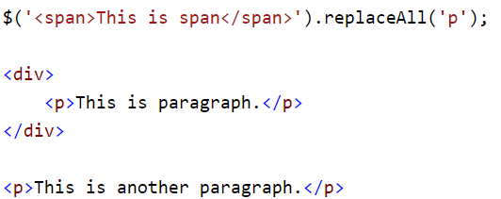
Example: JQuery replaceAll() Method
Try the code and check the output here.

Slide 62
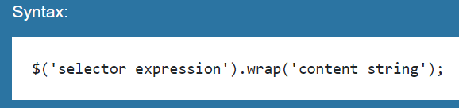
jQuery wrap() Method
The jQuery wrap() method wrap each target element with specified content element.

Slide 63
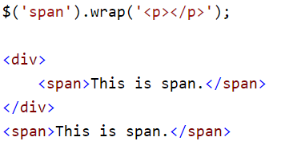
Example: JQuery wrap() Method
Try the code and check the output here.

Slide 64
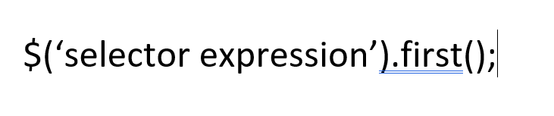
jQuery first() Method
Returns the first element of the selected elements

Slide 65
Example: JQuery first() Method
Try the code and check the output here.

Slide 66
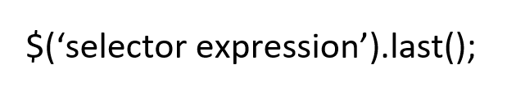
jQuery last() Method
Returns the last element of the selected elements

Slide 67
Example: JQuery last() Method
Try the code and check the output here.

Slide 68
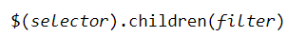
jQuery children() Method
Returns all direct children of the selected element

Slide 69
Example: JQuery children() Method
Try the code and check the output here.

Slide 70
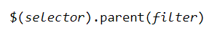
jQuery parent() Method
Returns the direct parent element of the selected element

Slide 71
Example: JQuery parent() Method
Try the code and check the output here.

Slide 72
jQuery Traversing Methods
Go through the Traversing Methods to get familiarize with the syntax

Slide 73

Homework
Students will practice exercises of the topics covered today from this link:
JQuery DOM Practice Exercises

Slide 74

Learning Objectives
By the end of this session, the students have practised
What is jQuery
jQuery Syntax
jQuery Selectors
Manipulating HTML DOM with jQuery

Slide 75
Conclusion & Q/A
See you tomorrow!

